Slide 1
Activity planning
Holly Evans

Slide 2
Contents
What are the reasons for producing an activity plan?
What are some guidelines for an effective activity plan?
Focusing on case study 1
Notes:
What are the reasons for producing an activity plan?
What are some guidelines for an effective activity plan?
Focusing on case study 1

Slide 3
Background info
A project activity plan includes a list of all the activities involved and a schedule indicating the start and completion times for each activity.
Planning should be done before a project begins. For effective planning, objectives and schedules should be clear and understandable.
Activity plans are a schedule representation that highlights dependencies between project activities or tasks.
The activity plan/chart shows which activities can be carried out – some in parallel or some which must be executed in sequence because of a dependency of an earlier project.
Notes:
A project activity plan includes a list of all the activities involved and a schedule indicating the start and completion times for each activity.
Planning should be done before a project begins. For effective planning, objectives and schedules should be clear and understandable.
Activity plans are a schedule representation that highlights dependencies between project activities or tasks.
The activity plan/chart shows which activities can be carried out – some in parallel or some which must be executed in sequence because of a dependency of an earlier activity/task.

Slide 4
What are the reasons for producing an activity plan?
Prevention of obstacles
Better utilisation of resources
Optimal usage of time for the project to be carried out
It checks feasibility of the schedule and user requirements
It determines project constraints
It defines the roles and responsibilities of the project management team members
Notes:
One of the reasons for producing an activity plan is that it prevents obstacles from arising in the project – such as changes within the organisations objectives, non-availability of resources etc.
Creating an activity plan also helps in better utilization of resources and optimal usage of the allocated time for the project.
It checks feasibility of the schedule and user requirements
It determines project constraints
It defines the roles and responsibilities of the project management team members

Slide 5
What are some guidelines for an effective activity plan?
Project background
Objectives
Scope
Constraints
Assumptions
Dependencies + impacts
Issues + risks
Methodologies and strategy
Controls: scope, time, cost, quality, resources
Communications
Schedule of delivery
Performance measurement
Notes:
Project background – information about the project.
Objectives – what is it that the project needs to achieve and how would you go about doing this?
Scope – define the scope of the project. You should define what is in the scope and what should be excluded from the scope. A starting point could be brainstorming all of the activities that need to be completed within the project. Challenge each of these activities to see if they are inside or outside of the scope. Be explicit about what is to be excluded as some of these may be external dependencies that need to be captured.
Constraints – is there a constraint that needs to be applied to the project and thus be incorporated into the activity plan. So that unwanted results can be prevented.
Assumptions – is there any information that needs to be assumed is the case before creating the activity plan?
Dependencies + impacts – this is where you would look at what needs to be done before something else can happen i.e. one activity is dependent on another activity being completed. These are particularly important especially if any changes are to be made to the plan.
Issues + risks – what could go wrong? What could happen that would damage the delivery of the project?
Methods and strategy – what methods and strategies will you use in order to create the most effective project outcome.
Controls: scope, time, cost, quality, resources – what is the scope as mentioned earlier, how much time is being allocated, what will be the cost implications of each activity, how will the quality be measured and what resources are available to complete the project.
Communications – how will the staff communicate on each activity.
Schedule of delivery – when is the project due to be delivered to the client?
Performance measurement – how will the performance be tested and measured to see if it is effective. This will also focus on how improvements to the system will need to be made and reported.

Slide 6
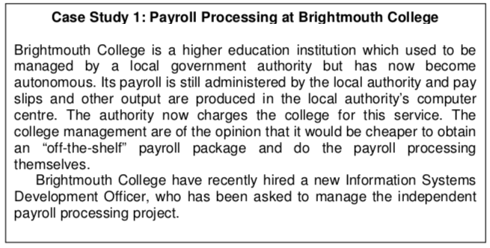
Case study
Notes:
Project background – Brightmouth college wants to carry out payroll processing themselves and have thus hired a new Information Systems Development Officer to manage the independent payroll processing project.
Objectives – effectively achieve in house payroll processing.
Constraints – are there any factors that will prevent certain actions being carried out by the college?
Assumptions – the Information Systems Development Officer has the adequate knowledge to manage and maintain the processing of payroll. Also assuming that the development officer will need others to help with each activity to be carried out. Assuming that the off the shelf payroll package is adequate enough to complete each of these activities.
Dependencies + impacts – dependent on each activity being correctly completed i.e. if an employee makes a mistake it could mean everyone's pay is incorrect. This in turn could cause problems if they are unable to pay their bills etc. This system could also be dependent on staff being at work i.e. sickness could cause an issue particularly if only a handful of employees are trained to use this.
Issues + risks – human error i.e. carrying out an activity wrongly such as inputting incorrect information. Having to train staff on how to use the new system could be problematic especially if they don’t have any experience with payroll. What would happen if the system went down and they were unable to carry out the in house processing of payroll?
Methodologies and strategy – how will the development officer go about setting up this processing system and is it going to be the most strategic way of processing the colleges payroll.
Controls: scope, time, cost, quality, resources – how much time will it take to get this process up and running, even though the college believes this will be cheaper what will be the cost implications. As having the extra employee i.e. a fairly qualified one could be costly, paying for additional training for staff to use the new system. Does the college have the resources to be able to carry this out i.e. the adequate equipment, employees etc.
Communications – if there is a problem who would the employees turn to for guidance? How will the employees discuss each activity to be completed.
Schedule of delivery – as this is a month to month processing the system would have to be in place rather quickly. When would the college stop using the local authority to carry out this action.
Performance measurement – would the new system need to be run alongside the current one in case any errors are made or to see the feasibility of this being carried out.

